Slide 1
PROWATER TECHNOLOGIES, INC.
Prowater Technologies, Inc. is one of the leading Specialist Water and Wastewater Treatment Company operating in the Philippines. The company supplies quality products and services to Cities and Municipalities and Manufacturing and Industrial Companies, as well as the Food Industry, Commercial and Hotels in the country.
Prowater focuses on customer service excellence and quality product supply, delivered through highly trained staff members who have invaluable experience and expertise in the Water and Wastewater Treatment Industry. This special knowledge enables team members to assist customers in a wide range of applications so that, the most cost effective solution to each water and wastewater treatment project is achieved.
Product innovation and development is a priority at Prowater. Joint research and development, in conjunction with strategic product manufacturers, places emphasis on new custom products. This advantage, ensures Prowater. continued leadership in product supply as well as the ongoing extension of the company’s product range.
These developments directly assist our customers, by reducing their production costs, as well as improving water quality supply.
Our Vision
Our vision is to achieve 100% customer satisfaction for our products, services and integrated solutions.
Our Mission
Our mission is to consistently provide a comprehensive range of high quality, cost effective and sustainable, water and wastewater treatment products and services to our valued customers, in order to satisfy their specific water service delivery needs and objectives.
Our Objective
It is our endevour to preserve the environment by contributing to
Its protection and focusing on sustainable development of communities.
Our Goal
Our goal is to be the kind of company that people want to work for, customers want to buy from, and suppliers want to sell to.
ABOUT US

Slide 2
PROWATER TECHNOLOGIES, INC.
Why Us?
Our Water and Wastewater Treatment Products are the best choice of our customers across the nation because of number of factors, which is as follow:
Competitive prices
Infrastructure
Experienced and expert team
Qualitative products
Customized yet cost-effective products/services
Service support after supply
Long list of satisfied customers
Application
Quality oriented products have a wide application in various industries. Following are applications of products:
Power Plants, Refineries, Petro-chemical and Oil & Gas
Food & Beverage, Restaurants and Food Chains
Automobile and other Manufacturing Plants
Hotels, Office & Commercial Buildings and Malls
Hospitals
Our Products and Services
Water Treatment
- Cooling Water Treatment
- Chilled Water Treatment
- Boiler Water Treatment
- Supply and Install of Water Softener
Wastewater Treatment
- Design & Construct of Sewage Treatment Plant (STP)/Wastewater Treatment Plant (WTP)
- Operation &Maintenance of STP/WTP
- Rehabilitation/Upgrading of STP/WTP
- Enzyme Treatment of Septic Tank
- Grease Trap Treatment & Hauling Services.
Specialty Cleaning Chemicals & Services
- Oil Tank Cleaning
- AHU Cleaning
- Pre-Operational Cleaning
- Water Tank Disinfection System (Super Chlorination)
- Descaling Services
OUR EXPERTISE

Slide 3
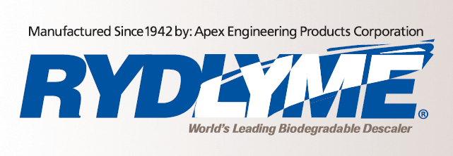
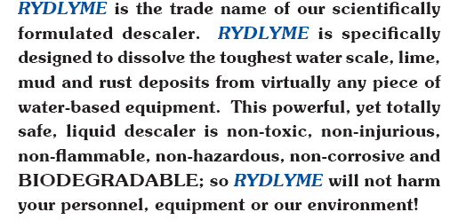
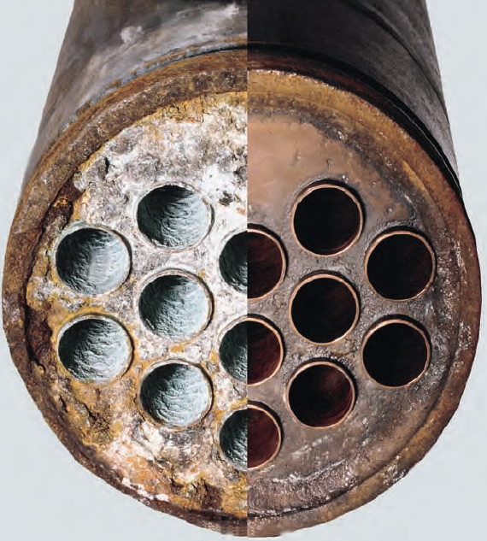
PROWATER TECHNOLOGIES, INC.
Exclusive Distributorship of:
EXCLUSIVE DISTRIBUTORSHIP

Slide 4

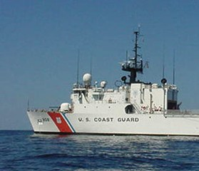
PROWATER TECHNOLOGIES, INC.
Exclusive Distributorship of:
RYDLYME Marine... The Ultimate Biodegradable Marine Descaler!
RYDLYME Marine is a biodegradable, marine descaler designed for the maritime industry to safely dissolve calcium, rust, barnacles and other mineral deposits that hinder the performance of vital water systems.
RYDLYME Marine can be used on all types of vessels, including workboats, cruise ships, mega-yachts, freighters and even recreational boats. This revolutionary descaler can help you save money by removing unwanted marine deposits on heat exchangers, engine cooling systems, condensers and much more!
EXCLUSIVE DISTRIBUTORSHIP

Slide 5
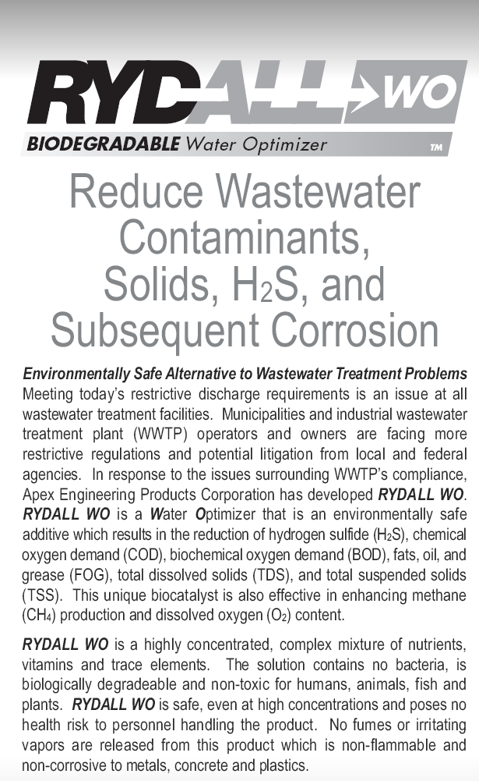
PROWATER TECHNOLOGIES, INC.
Exclusive Distributorship of:
EXCLUSIVE DISTRIBUTORSHIP

Slide 6
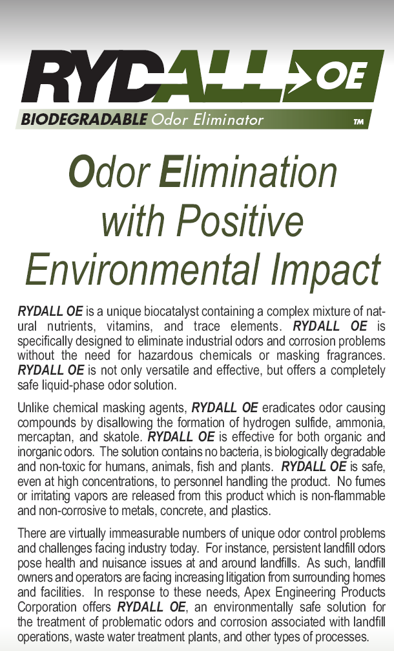
PROWATER TECHNOLOGIES, INC.
Exclusive Distributorship of:
EXCLUSIVE DISTRIBUTORSHIP

Slide 7
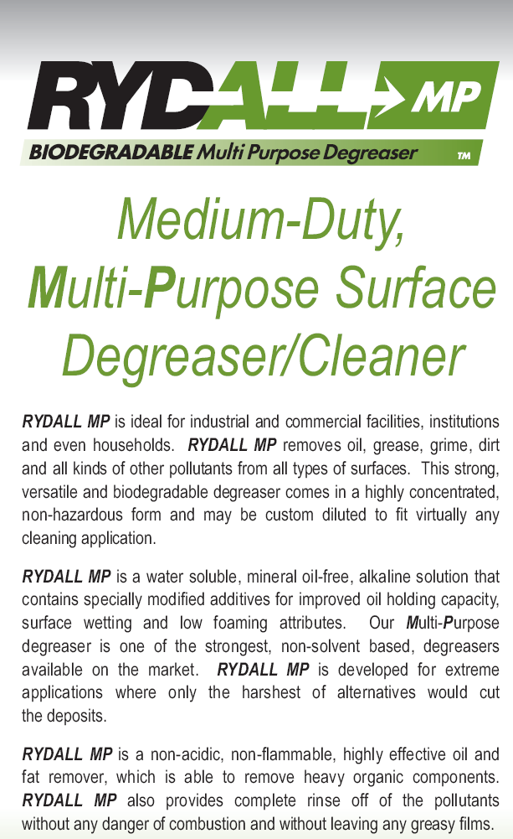
PROWATER TECHNOLOGIES, INC.
Exclusive Distributorship of:
EXCLUSIVE DISTRIBUTORSHIP

Slide 8

PROWATER TECHNOLOGIES, INC.
Exclusive Distributorship of:
EXCLUSIVE DISTRIBUTORSHIP

Slide 9
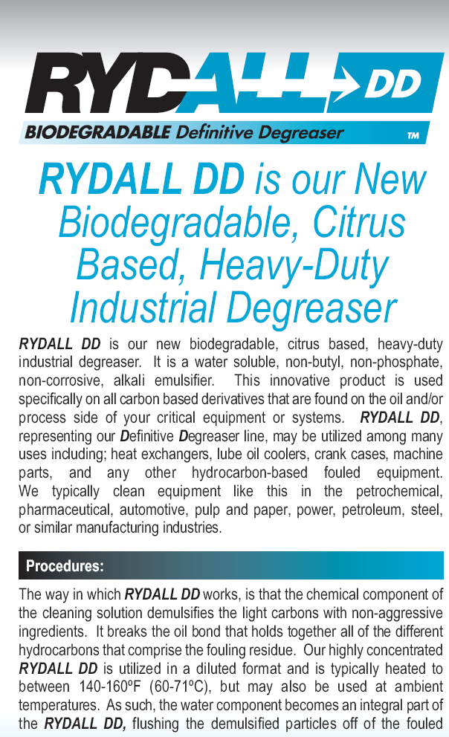
PROWATER TECHNOLOGIES, INC.
Exclusive Distributorship of:
EXCLUSIVE DISTRIBUTORSHIP

Slide 10

PROWATER TECHNOLOGIES, INC.
Exclusive Distributorship of:
EXCLUSIVE DISTRIBUTORSHIP

Slide 11
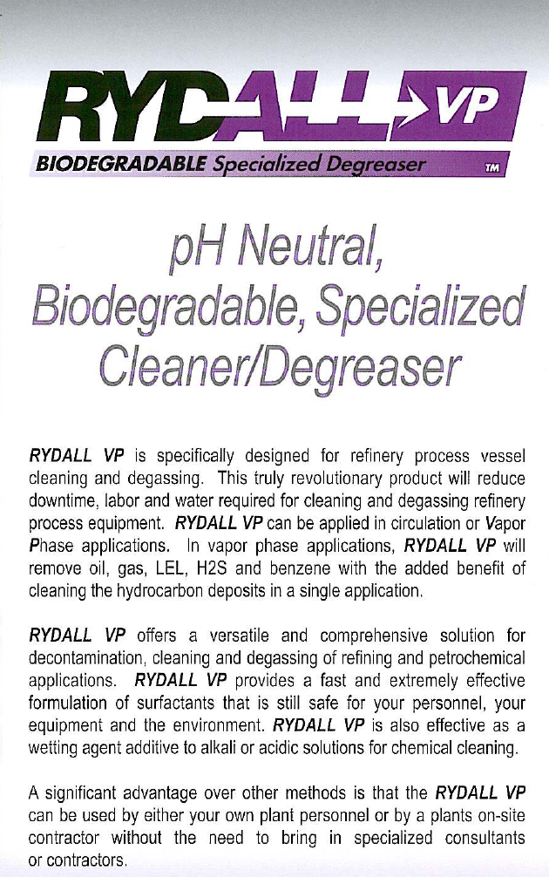
PROWATER TECHNOLOGIES, INC.
Exclusive Distributorship of:
EXCLUSIVE DISTRIBUTORSHIP

Slide 12
PROWATER TECHNOLOGIES, INC.
Hotels, Office & Commercial Buildings and Malls
Raffles & Fairmont
Grease Traps Treatment & Hauling Services
Enzyme Treatment of Septic Tank
Posh Properties Development Corporation
Cooling Water Treatment of 2 Shopping Center
Chilled Water Treatment of 2 Shopping Center
Tokiko Industrial Resources, Inc.
Cooling Water Treatment of Nutriasia Tower 1
Chilled Water Treatment of Nutriasia Tower 1
Pre-Operationall Cleaning of Nutriasia Tower 1
Mactan Cebu Inaternational Airport Authority
Supply of 6%AFFF
Supply of BC Dry Chemicals
City Government of Calamba
Design & Construct of Sewage Treatment Plant of BJMP
Operational & Maintenance of of STP of Calamba Cityhall and Calamba City Market
Automobile and other Manufacturing Plants
Toyota Motors Philippines Corporation
Cooling Water Treatment
Boiler Water Treatment
Descaling Services
Supply and Install Water Softener
Power Plants, Refineries, Petro-chemical and Oil & Gas
Shell Philippines Exploration B.V.
Descaling Services Using Rydlyme
OUR CLIENTS

